Slide 1
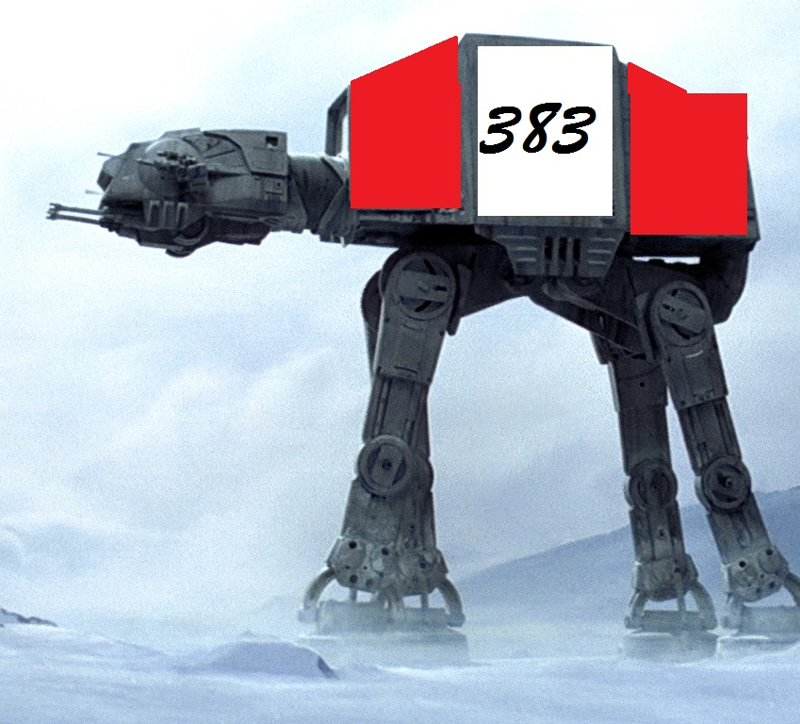
Sound Sentinel by 383

Slide 2
Sound Sentinel
Things to put here….
Name
Goal
Story

Slide 3
383 Studios
Austin
Tyrel
Amanda
Tristan

Slide 4
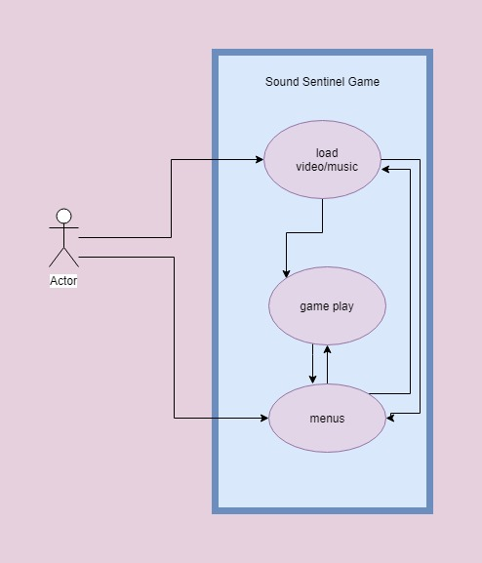
Global Use Case

Slide 5
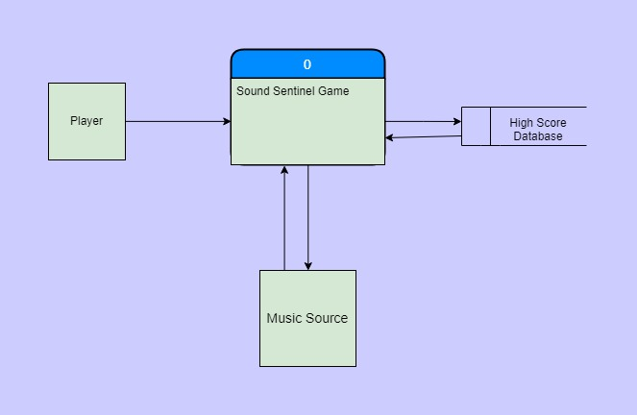
Context Diagram

Slide 6
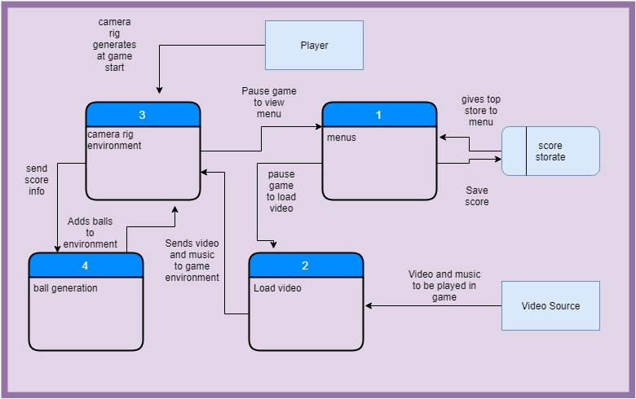
Diagram 0

Slide 7
Austin

Slide 8
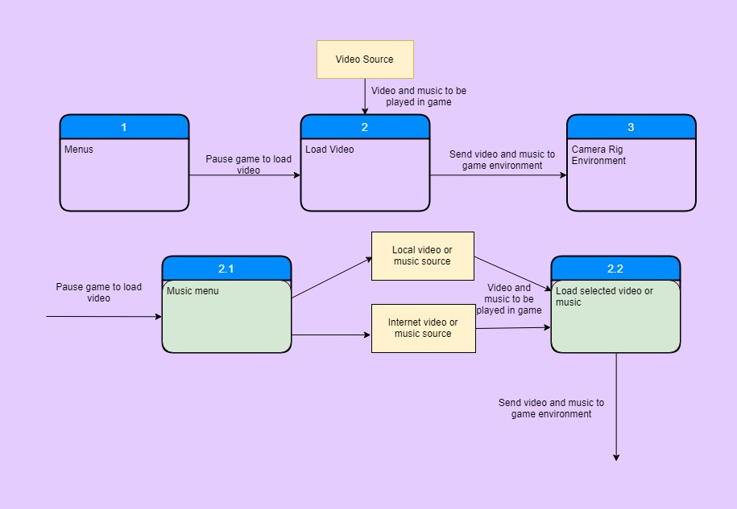
Tyrel

Slide 9
Amanda

Slide 10
Tristan

Slide 11

Questions?

